Slide 1
“ What ingredient do you have? ”
Product similarity for home cook

Slide 2
กชกร เลื่อนสุขสันต์ 6310412001
สลิลวสุ เที่ยงธรรม 6310412017
สุพัตรา ตั้งสกุลระหง 6310412028

Slide 3
AGENDA
Why’s this project ?
Where we get the data?
Data Preparation
Result
Future Development

Slide 4
Why’s this project?
1
What can we use the ingredients for?
2
What do I need to add?
3
Get what you want or not?
4
Where can we buy the ingredient?

Slide 5
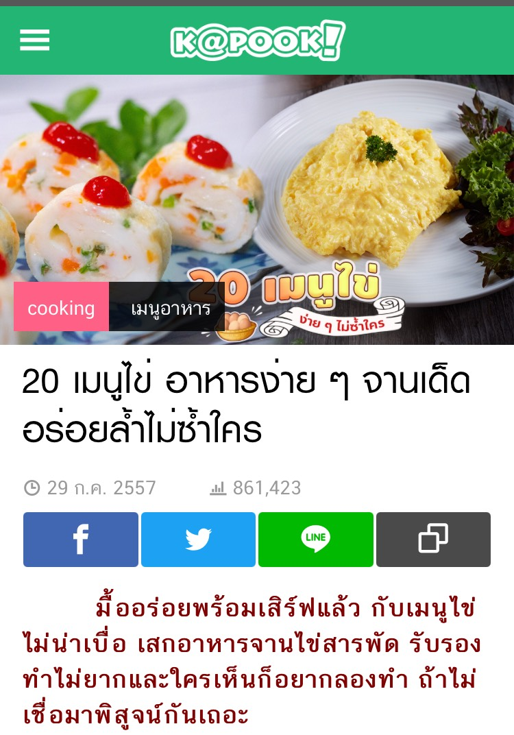
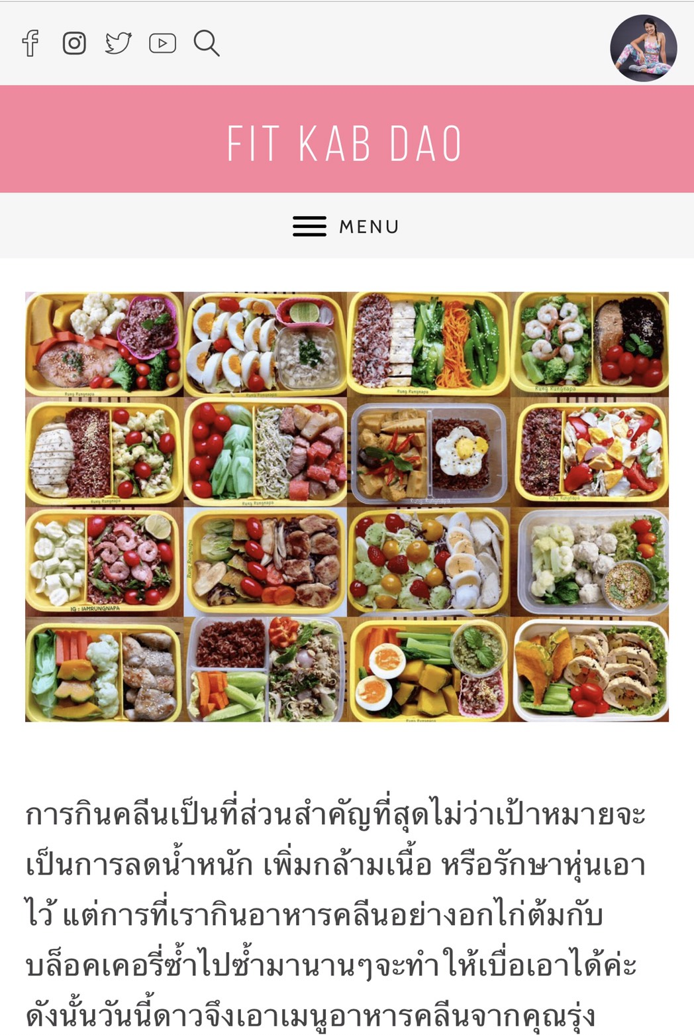
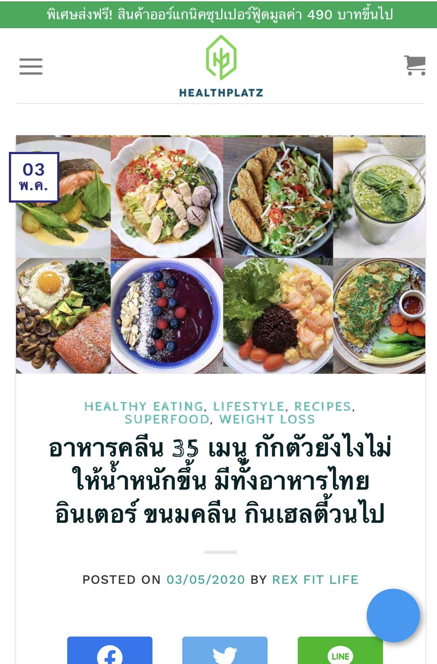
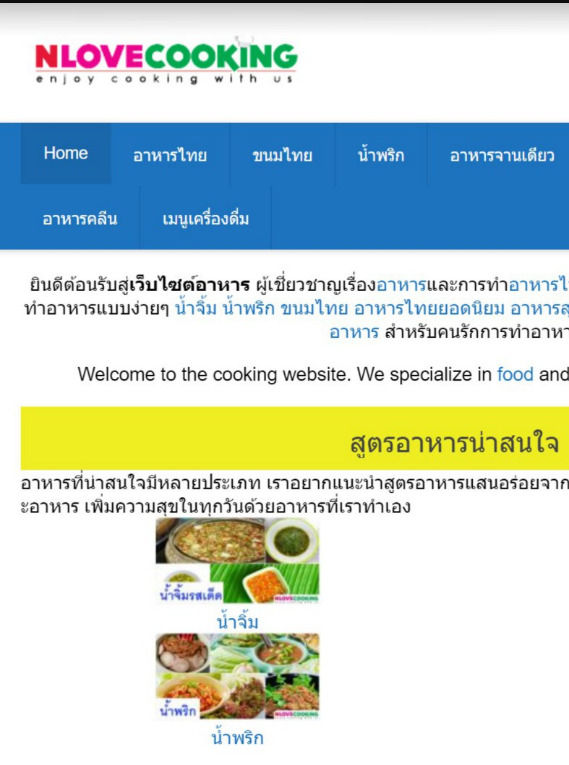
Where we get the data?
KAPOOK
FIT KAB DAO
HEALTHPLATZ
NLOVECOOKING

Slide 6
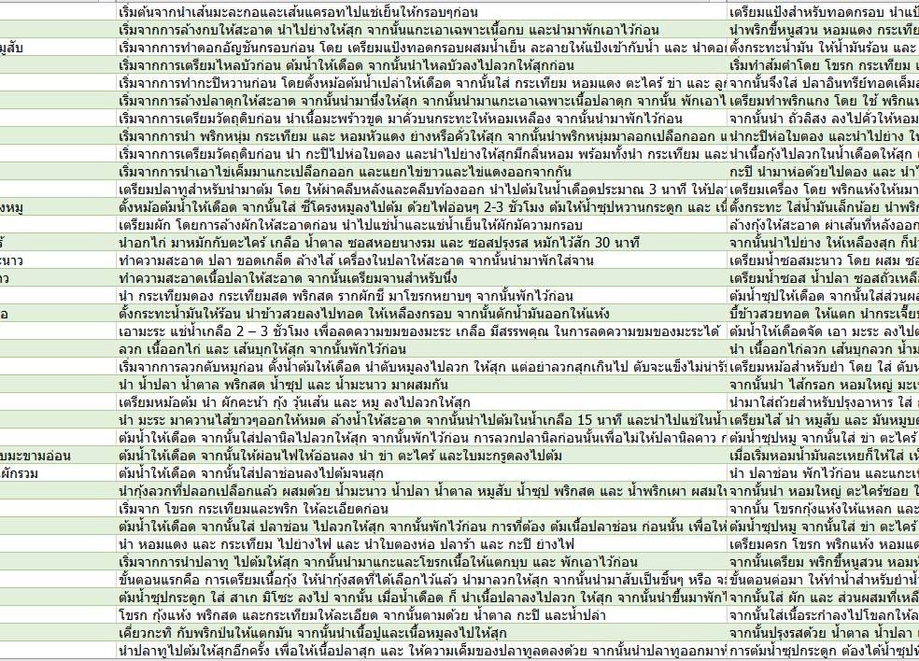
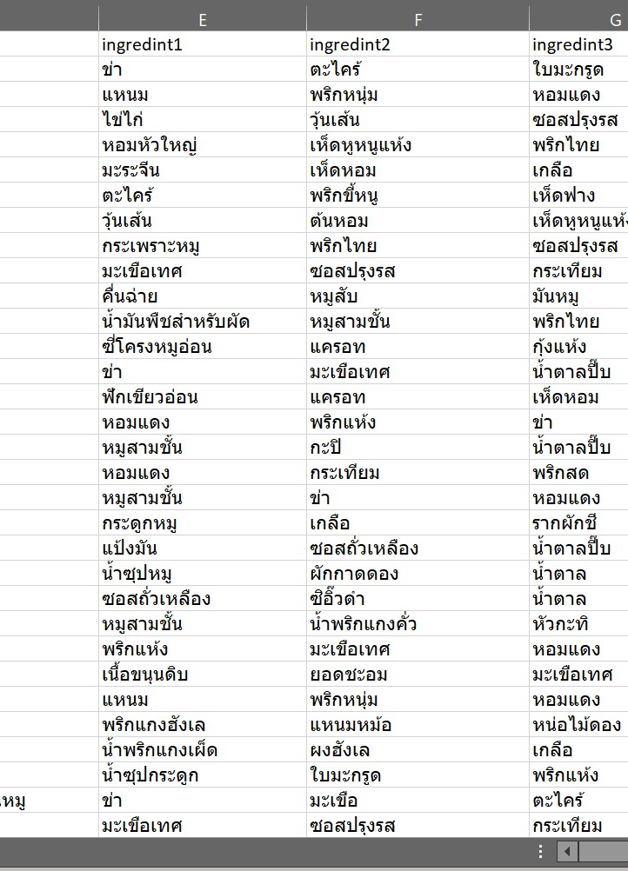
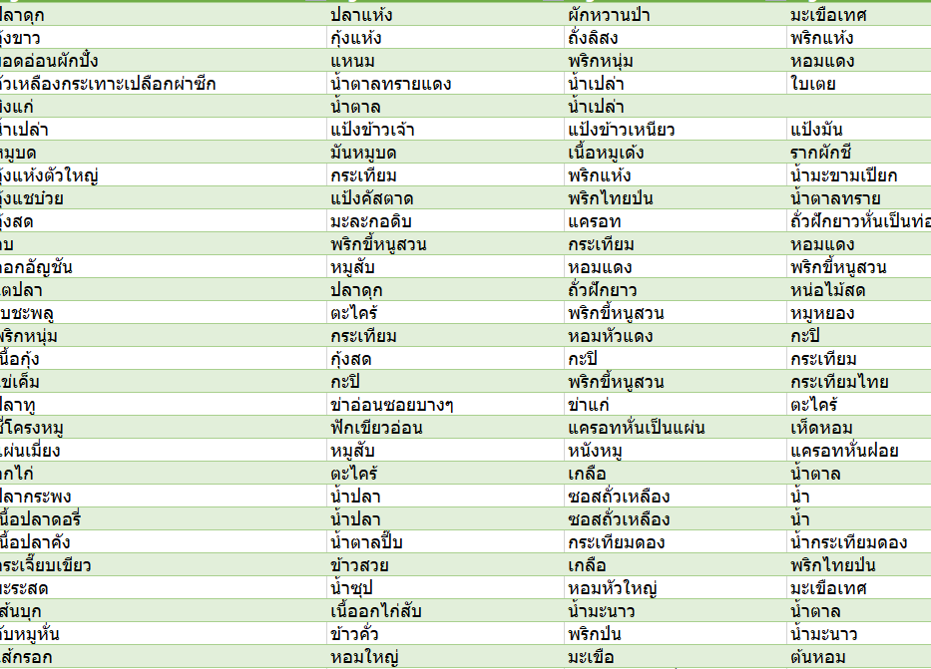
DATA PREPARATION
Using Excel for cleaning outlier

Slide 7
Data analysis
Using Cosine Similarity
to create Association making recommendations based on the rules

Slide 8
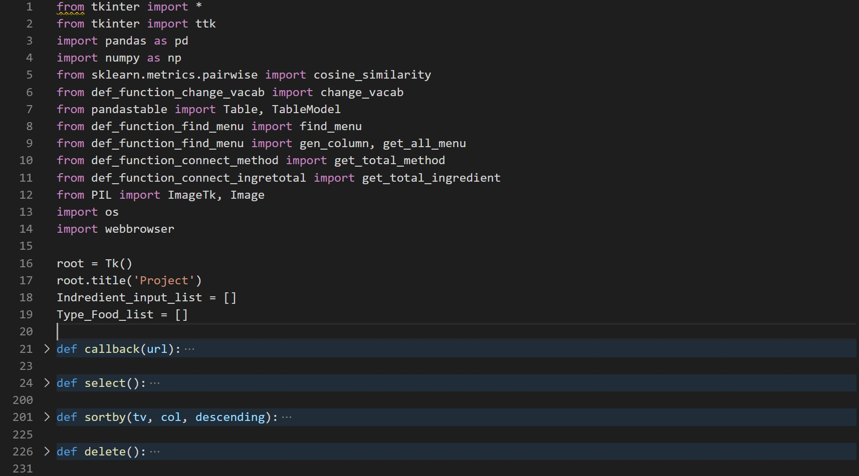
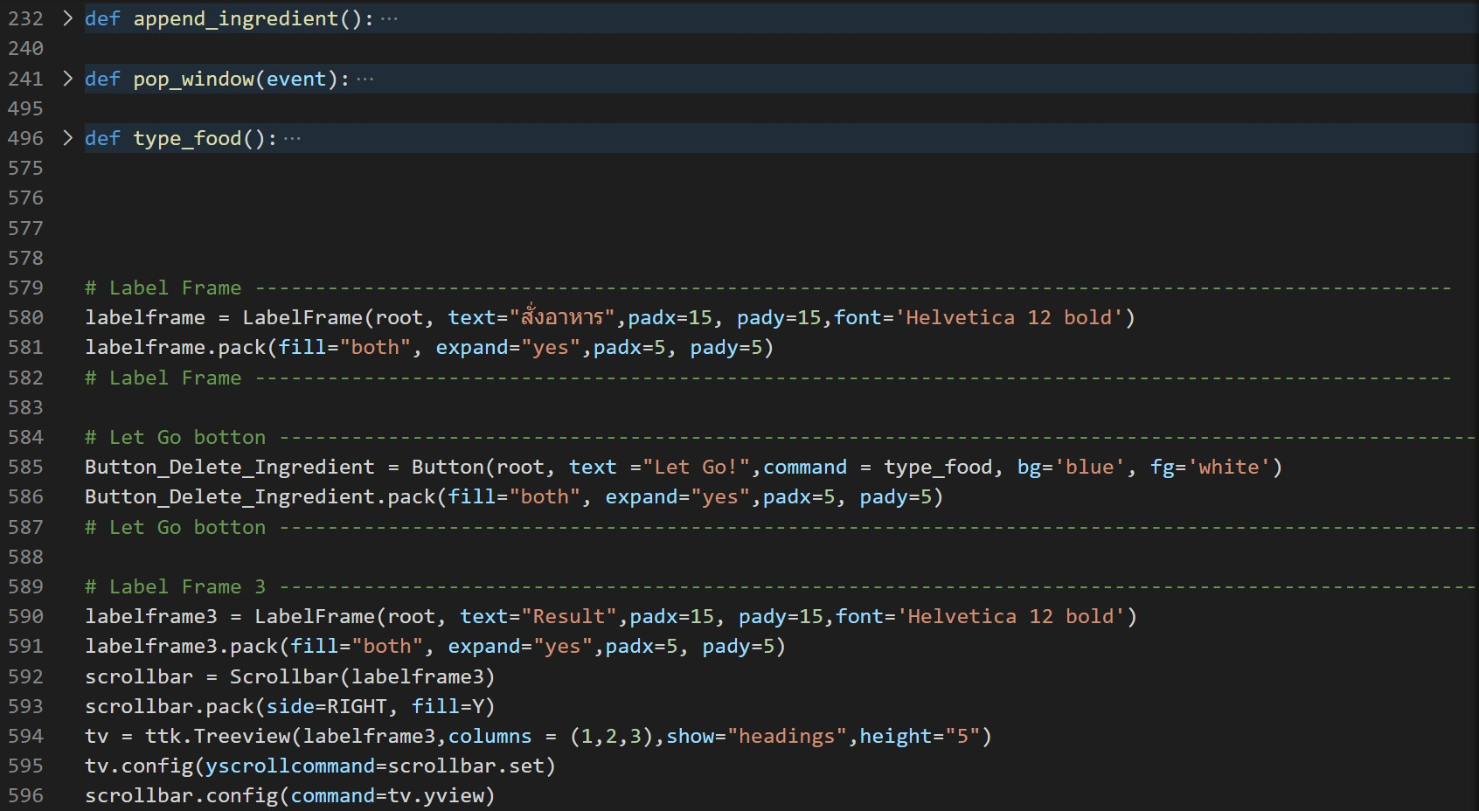
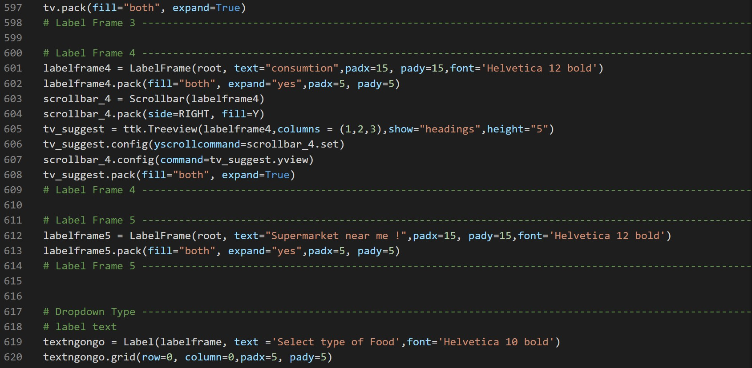
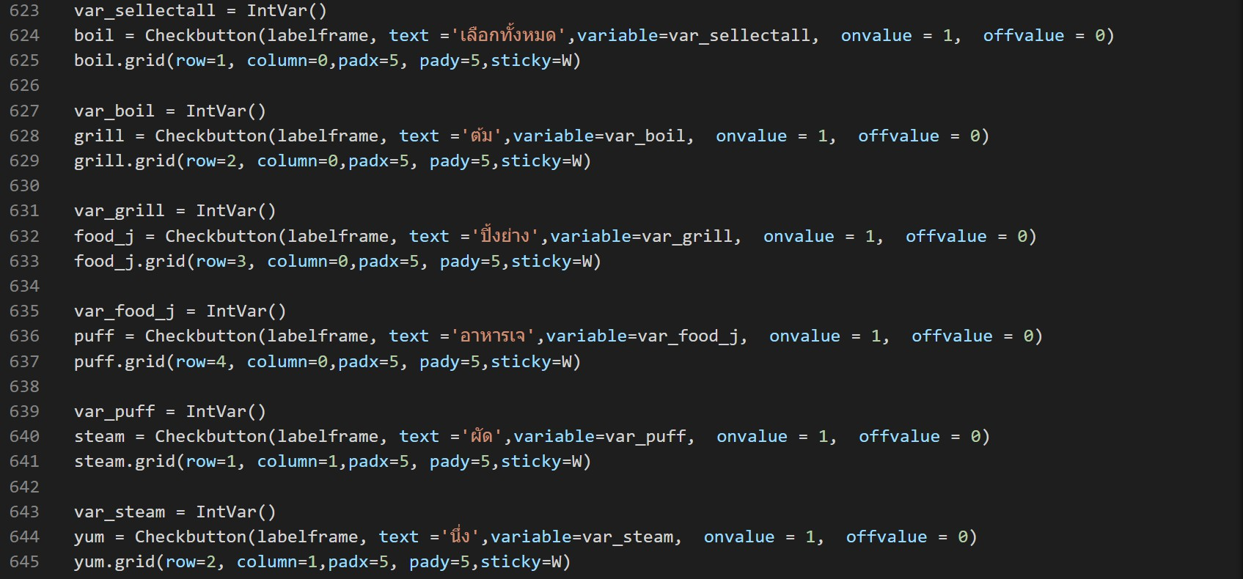
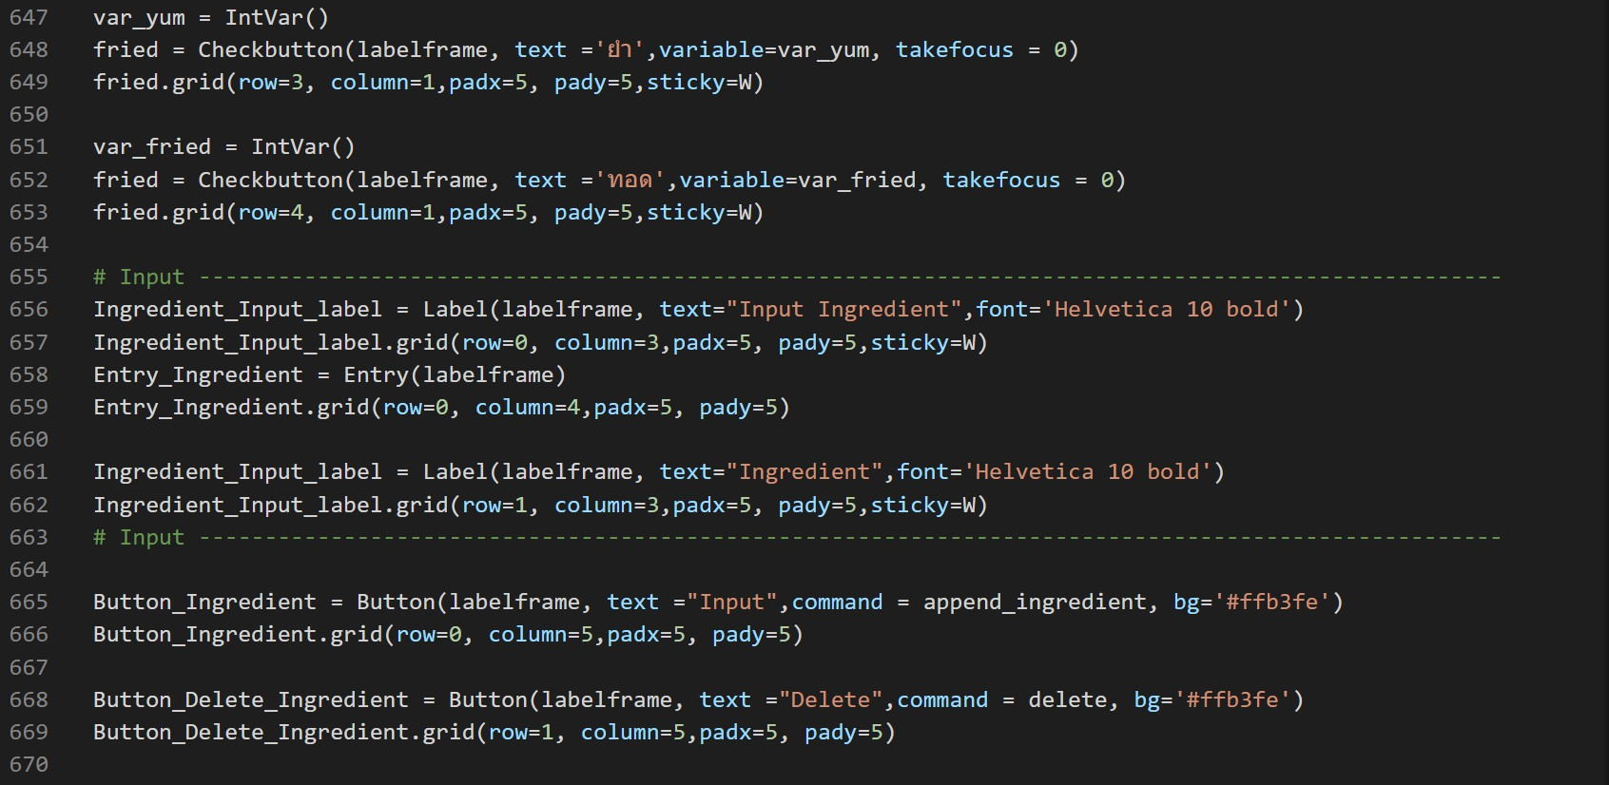
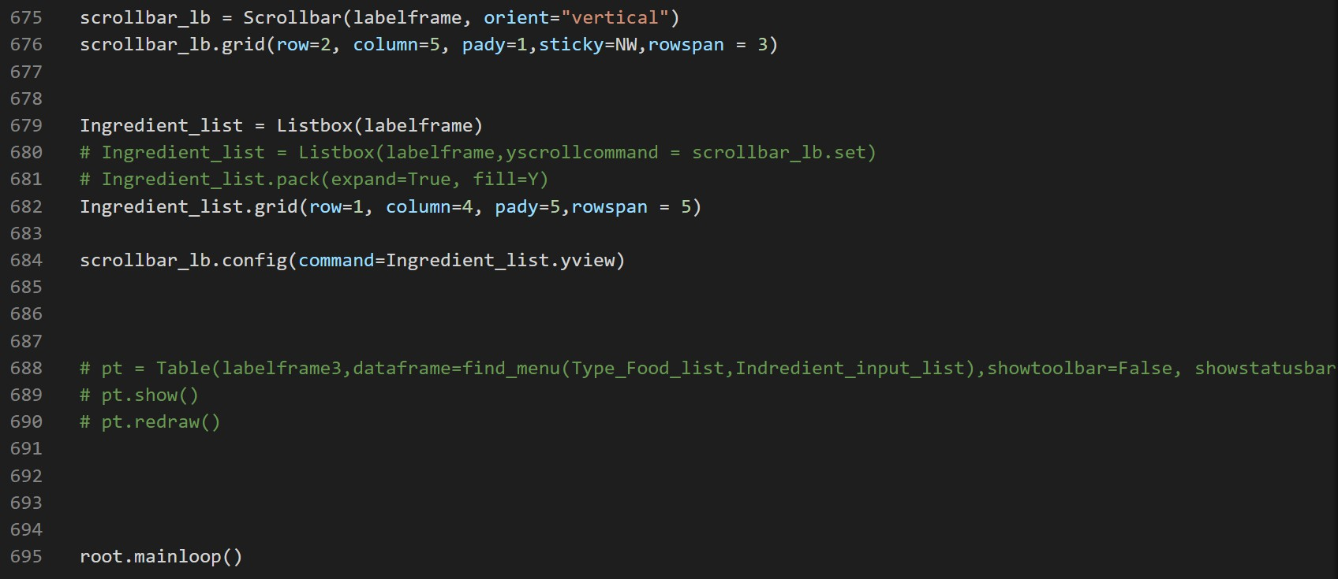
APPENDIX
(ดูต่อในfile Programe_What_ingredient_do_you_have.py ใน folder)

Slide 9
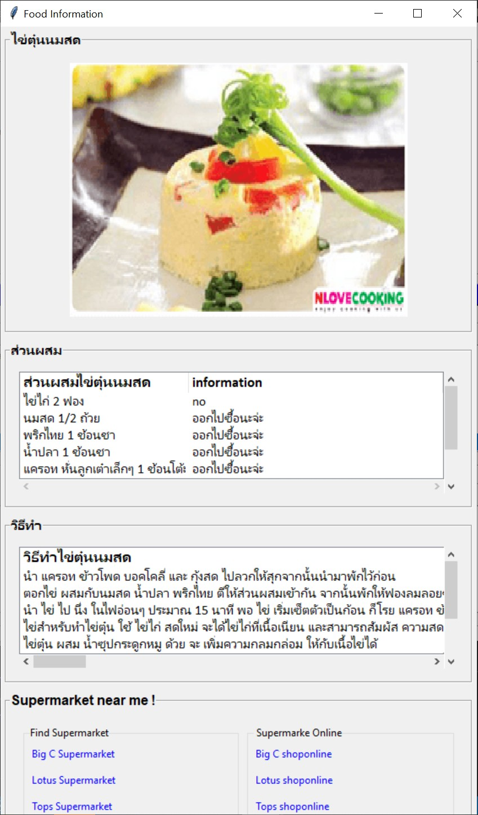
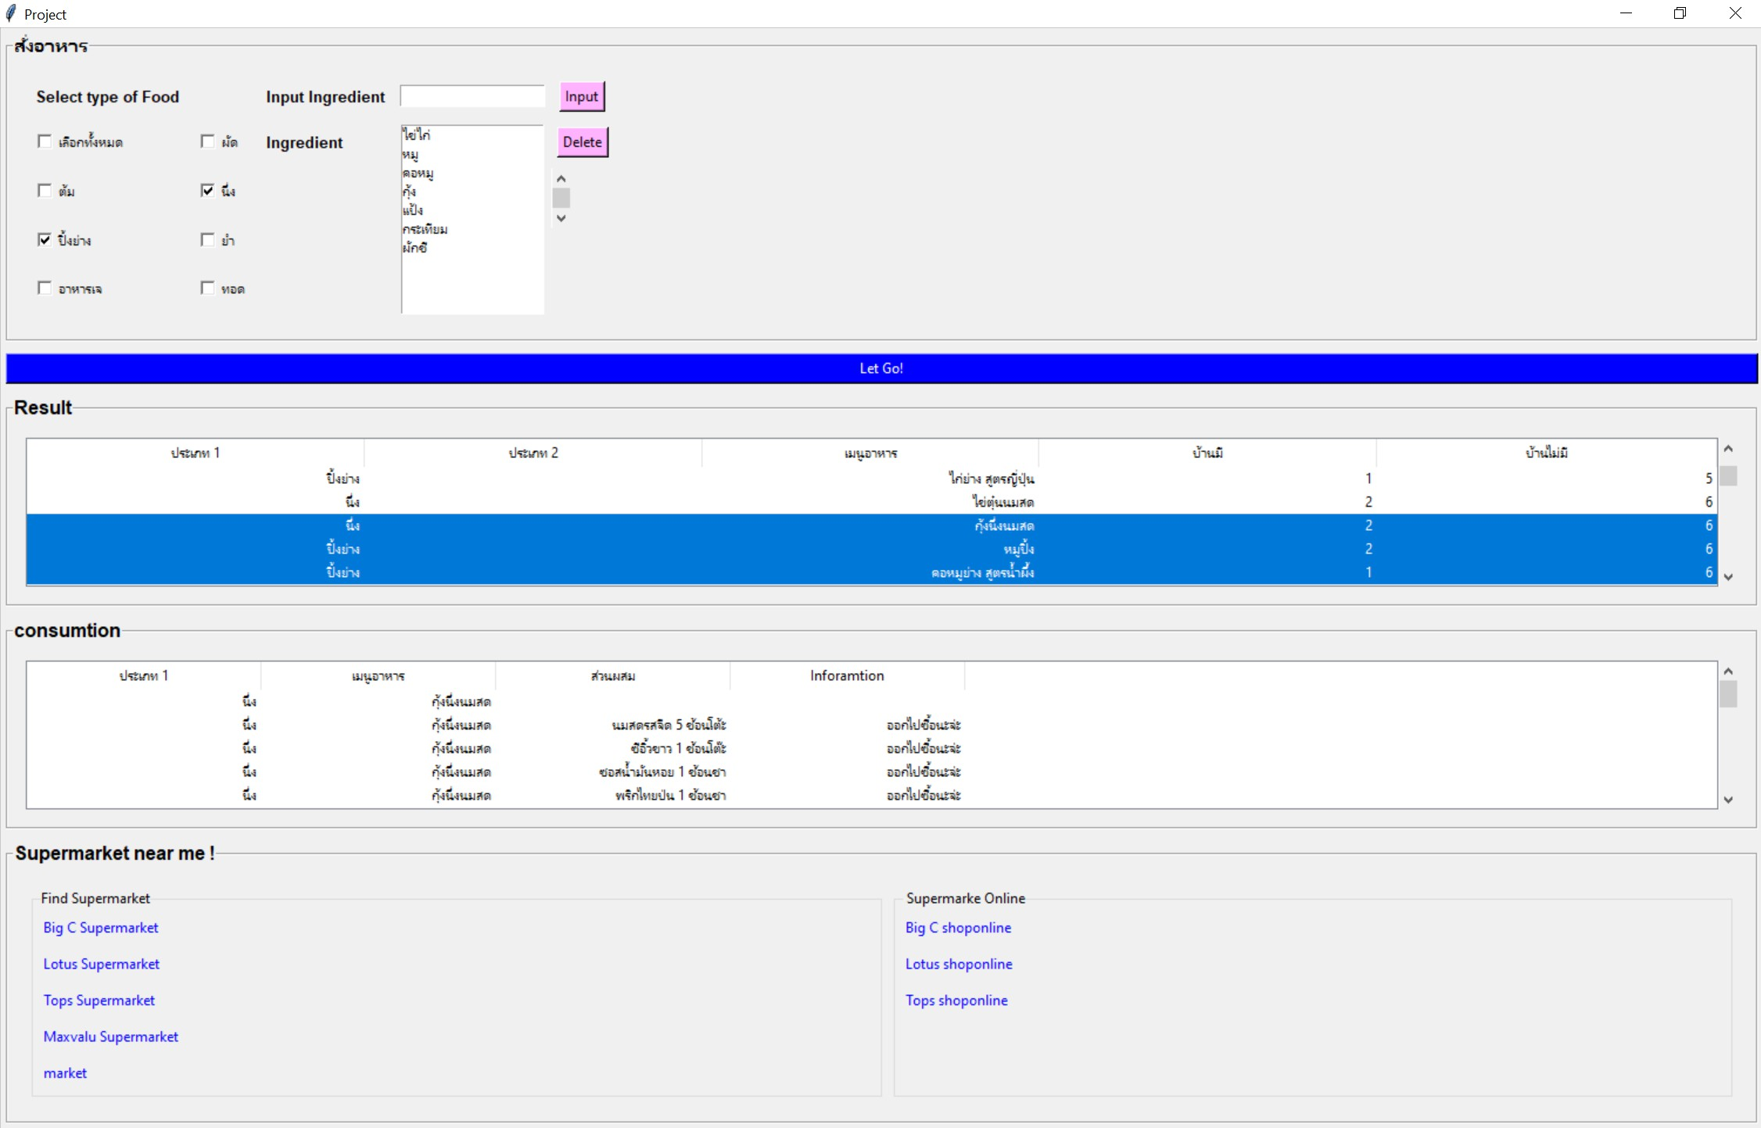
Result

Slide 10
Future Development

Slide 11
Thank you
Have a good meal

